Slide 1
UNIX SYSTEM PROGRAMMING
Socket

Slide 2
Sockets are communication points on the same or different computers to exchange data.
Sockets allow communication between two different processes on the same or different machines.

Slide 3
Where is Socket used?
A Unix Socket is used in a client server application frameworks.
A server is a process which does some function on request from a client.
Most of the application level protocols like FTP, SMTP and POP3 make use of Sockets to establish connection between client and server and then for exchanging data.

Slide 4
Socket Types
Stream Sockets
Datagram Sockets
Raw Sockets
Sequenced Packet Sockets

Slide 5
Stream Sockets: Delivery in a networked environment is guaranteed.
Data will arrive in the same order : If you send through the stream socket three items "A,B,C", if will receive as "A,B,C".
TCP protocol is used for data transmission.
If delivery is impossible, the sender receives an error indicator.
Data records do no have any boundaries.

Slide 6
Datagram Sockets: Delivery in a networked environment is not guaranteed.
They're connectionless because you don't need to have an open connection as in Stream Sockets - you build a packet with the destination information and send it out.
They use UDP (User Datagram Protocol).

Slide 8
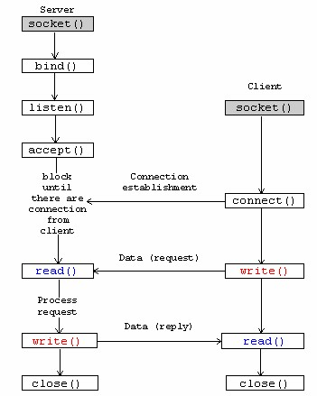
Socket

Slide 9
Socket – System Calls
int socket(int domain, int type, int protocol);
int bind(int sockfd, struct sockaddr *my_addr, socklen_t addrlen);
int listen(int s, int backlog);
int accept(int s, struct sockaddr *addr, socklen_t *addrlen);
int connect(int sockfd, const struct sockaddr *serv_addr, socklen_t addrlen);

Slide 10
socket
Socket creates an endpoint for communication and returns a descriptor.
socket(AF_INET , SOCK_STREAM , 0);
Domain | Description
AF_INET | IPv4 Internet domain
AF_INET6 | IPv6 Internet domain
Type | Description
SOCK_DGRAM | fixed-length, connectionless, unreliable messages (UDP)
SOCK_STREAM | sequenced, reliable, bidirectional, connection-oriented byte streams (TCP)

Slide 11
bind
bind - bind a name to a socket
int bind(int sockfd, struct sockaddr *my_addr, socklen_t addrlen);
struct sockaddr_in ser_sock;
ser_sock.sin_family = AF_INET;
ser_sock.sin_port = htons(8000);
ser_sock.sin_addr.s_addr = inet_addr("127.0.0.1");
struct sockaddr *ptrsockaddr = (struct sockaddr *) &ser_sock;
int size = sizeof(ser_sock);
bind(ser_fd , ptrsockaddr , size);
Notes:
Port No should be greater than 4000.

Slide 12
listen
int listen(int s, int backlog);

Slide 14
